Slide 1
German Breweries in Texas
Austin Humphrey
JAH7324

Slide 2
Overview
Every community possessing a sizable German population (except Nacogdoches and El Paso) in Texas established a brewery.
Innovations such as pasteurization, railroads, and refrigeration led to rapid growth, allowing breweries access to an entirely new market of customers.
Beginning as personal home projects, breweries slowly grew into commercial businesses that sold beer locally, and eventually became large, mechanized established which competed nationwide.

Slide 3
Home Brewing
After immigrating to Texas in 1842, home breweries became common among Germans.
Due to the breweries’ small scale, the 1850 census listed only 19 brewers and distillers.
Home brewers weren’t looking to turn a profit, just have available beer in newly settled towns.
Technological limitations (no railroad, refrigeration, pasteurization, etc.) prevented transport of beer to areas far away without spoiling its quality.

Slide 4
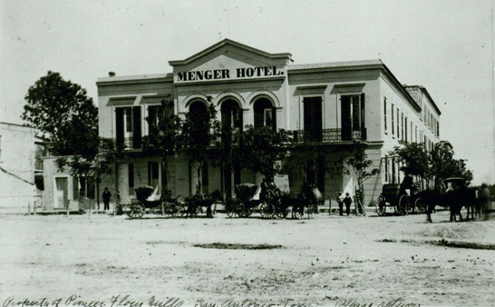
Rise of Commercial Breweries
As Germans settled down, the size of their breweries began to grow.
William Menger’s Western Brewery (1855-1878):
Formed in San Antonio in 1855.
Considered the first commercial brewery.
Largest brewery in Texas when it shutdown in1878.
Heinrich Kreische’s Kreische Brewery:
Opened in La Grange in 1872.
Considered second commercial brewery in Texas.
By 1979, became the third largest brewery in the state.
Many brewers were also in the hospitality business, running hotels on the side.
Ex: William Menger (San Antonio), Thomas Ingenhuitt (Comfort), Charles Nimitz (Fredericksburg)

Slide 5
Rise of Mechanized, Large-Scale Breweries
With easier transportation of goods via railroads, Texas breweries exponentially grew in order to compete on the national stage.
Lone Star Brewery (1884-1918):
Built in San Antonio in 1884
Formed by Adolphus Busch and a group of local San Antonio businessmen.
First large-scale, mechanized brewery in Texas.
Sold beer in California, Mexico, and Texas.

Slide 6
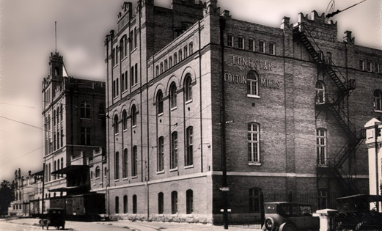
Lone Star Brewery

Slide 7
German Breweries: Prohibition Era
Beginning on January 16, 1919, 13 commercial breweries across Texas were shutdown.
Brewers were forced to dabble in other professions temporarily.
Otto Koehler’s Pearl Brewery made ice cream and ran a sign company.
Kosmos Spoetzl (owner of Shiner) sold ice.
For the most part, only larger Texas breweries were able to survive the prohibition era and reopen afterwards.

Slide 8
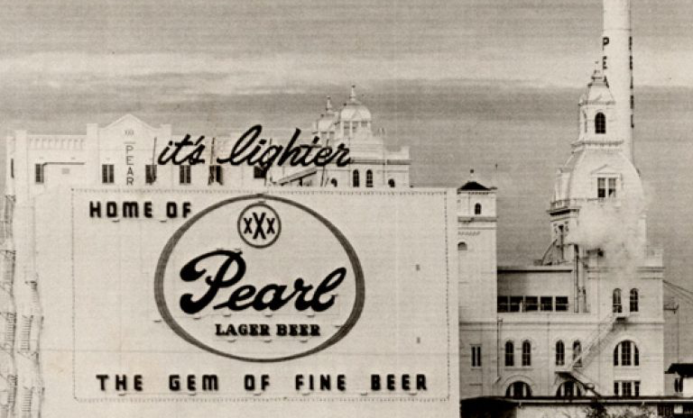
Pearl Brewery (San Antonio)

Slide 9
Sources
http://www.hillcountrypassport.com/256-those-first-germans-and-their-breweries
http://www.texasbreweries.com/except.htm
https://tshaonline.org/handbook/online/articles/dib01
https://en.wikipedia.org/wiki/Monument_Hill_and_Kreische_Brewery_State_Historic_Sites

